Slide 1
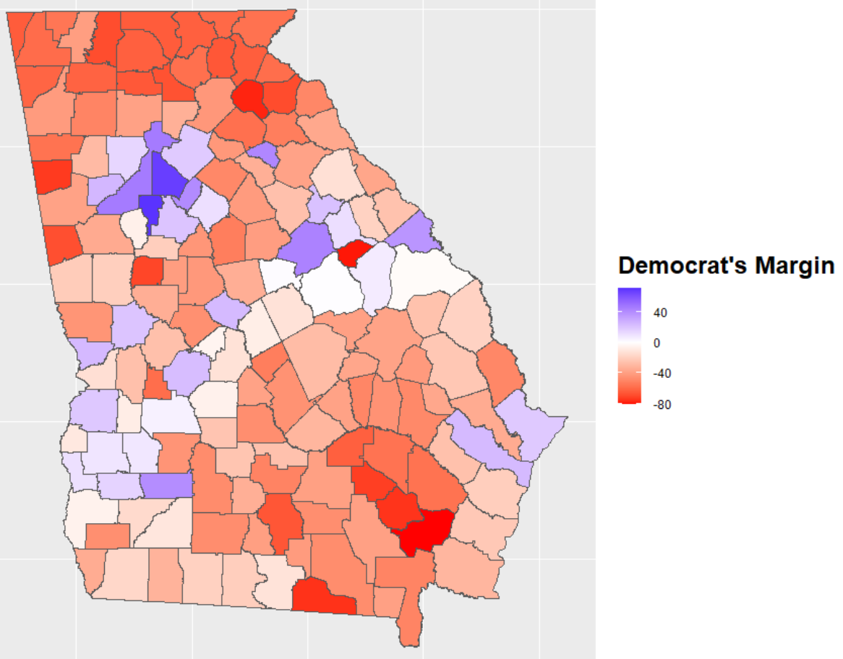
Georgia: The New Battleground
By: Albert Yen, Christina Mooshil, Joshua Ramirez, Manthan Gokalgandhi
Notes:
Albert

Slide 2
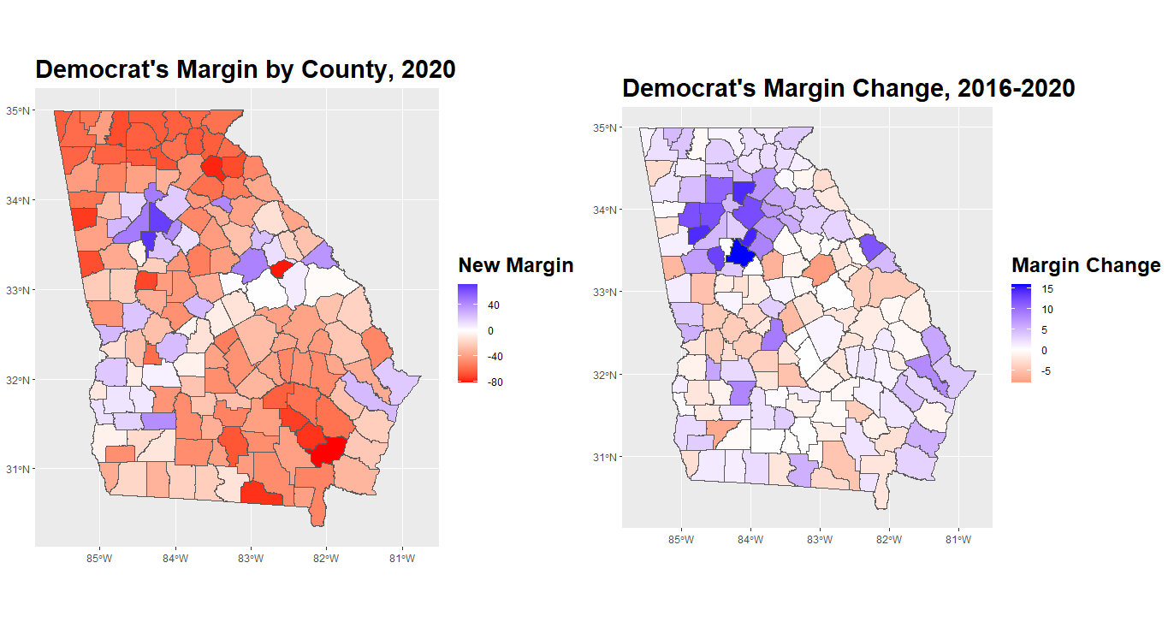
Statewide Result:
Biden 49.50%
Trump 49.25%
2016 Result:
Clinton 45.35%
Trump 50.44%
Notes:
Albert

Slide 3
Hypotheses Tested
Biden’s Vote Share is higher in urban and suburban counties than in rural counties.
Urban counties are more diverse.
More diverse counties are more Democratic-leaning.
Racial composition is a strong predictor of Democratic performance.
Vote method preference of urban, suburban, and rural voters are different
Vote method preference of Biden and Trump voters are different
Test the hypothesis that the mean of Turnout (the total votes of the 2020 election) is greater than the mean of 2016 (the total votes of the 2016 election)
Test the hypothesis that the mean of the youth voters in each county in Georgia is equal to 20
Notes:
Manthan

Slide 4
Methods
Map visuals of vote share, margin change, age, and racial composition
Bar plots for vote share analysis
Linear regression between whiteness of county and Democratic vote share
Linear regression between education, income, and population density vs. swing to Democrats
T-test for turnout change and mean share of youth voters
Chi Squared Test on Vote Method by party and urbanicity
Notes:
Manthan

Slide 5
Statewide Result:
Biden 49.50%
Trump 49.25%
2016 Result:
Clinton 45.35%
Trump 50.44%
Notes:
Albert

Slide 6
Results: Summary Statistics of Categorical Variables
2016 Party Results by County 2020 Party Results by County
Democrat | Republican
31 | 128
Democrat | Republican
30 | 129
Democrat Proportion | Republican Proportion
19.497% | 80.503%
Democrat Proportion | Republican Proportion
18.868% | 81.13%
Notes:
Christina

Slide 7
Results: Summary Statistics of Quantitative Variables
 | Education Percentage by County | Median Household Income by County
Mean | 24.56 | $40,203.28
Standard Deviation | 9.22 | $11,327.29
Range | 10.8 - 55.6 | $22,188 - $87,605
Summary | Min. 1st Qu. Median 10.80 18.05 21.80 Mean 3rd Qu. Max. 24.55 27.70 55.60 | Min. 1st Qu. Median $22,188 $32,550 $37,522 Mean 3rd Qu. Max. $40,203 $42,998 $87,605
Notes:
Christina

Slide 8
Summary Statistics: Contingency Tables
Party by Urbanicity - 2016 Election
 | Rural | Suburban | Urban
Democrat | 15 | 8 | 8
Republican | 106 | 22 | 0
Party by Urbanicity - 2020 Election
 | Rural | Suburban | Urban
Democrat | 14 | 8 | 8
Republican | 107 | 22 | 0
Notes:
Christina

Slide 9
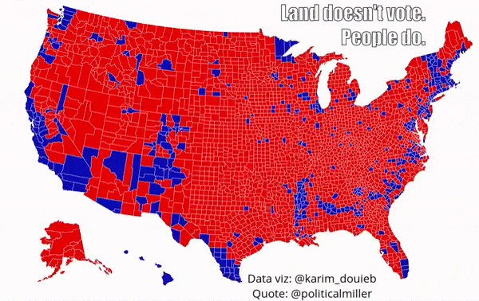
2016 Election
Notes:
Christina

Slide 10
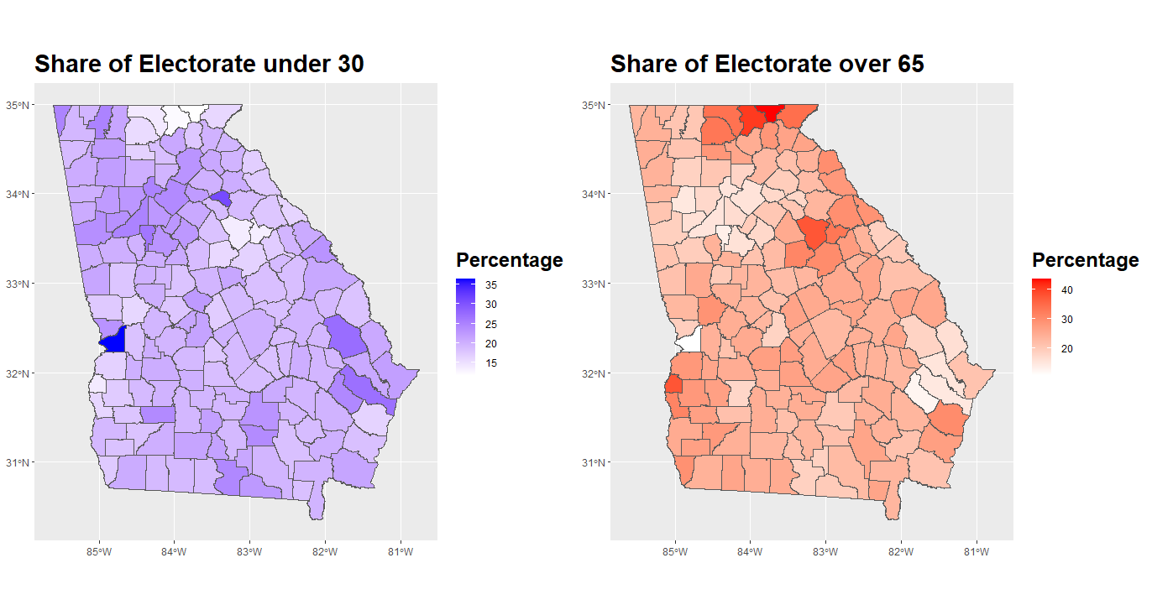
Age Distribution
Notes:
Joshua
The dark blue county is Columbus, where Columbus State University is located

Slide 11
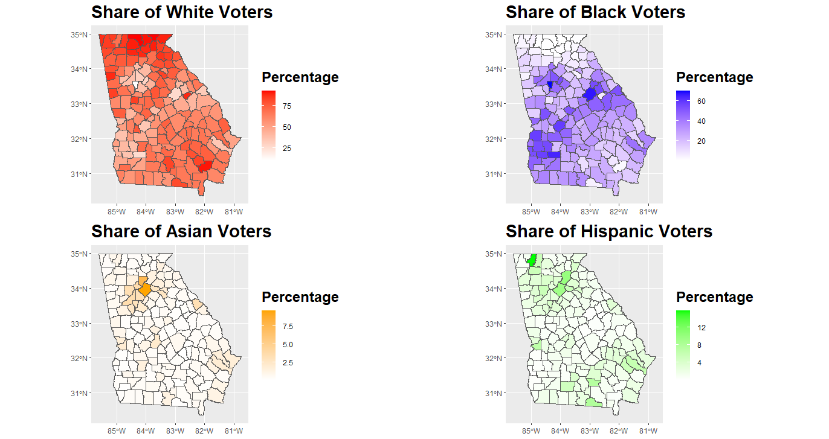
Racial Demographic Overview
Notes:
Manthan
Be sure to note that there’s an “unknown” category that’s mostly made up of minorities.

Slide 12
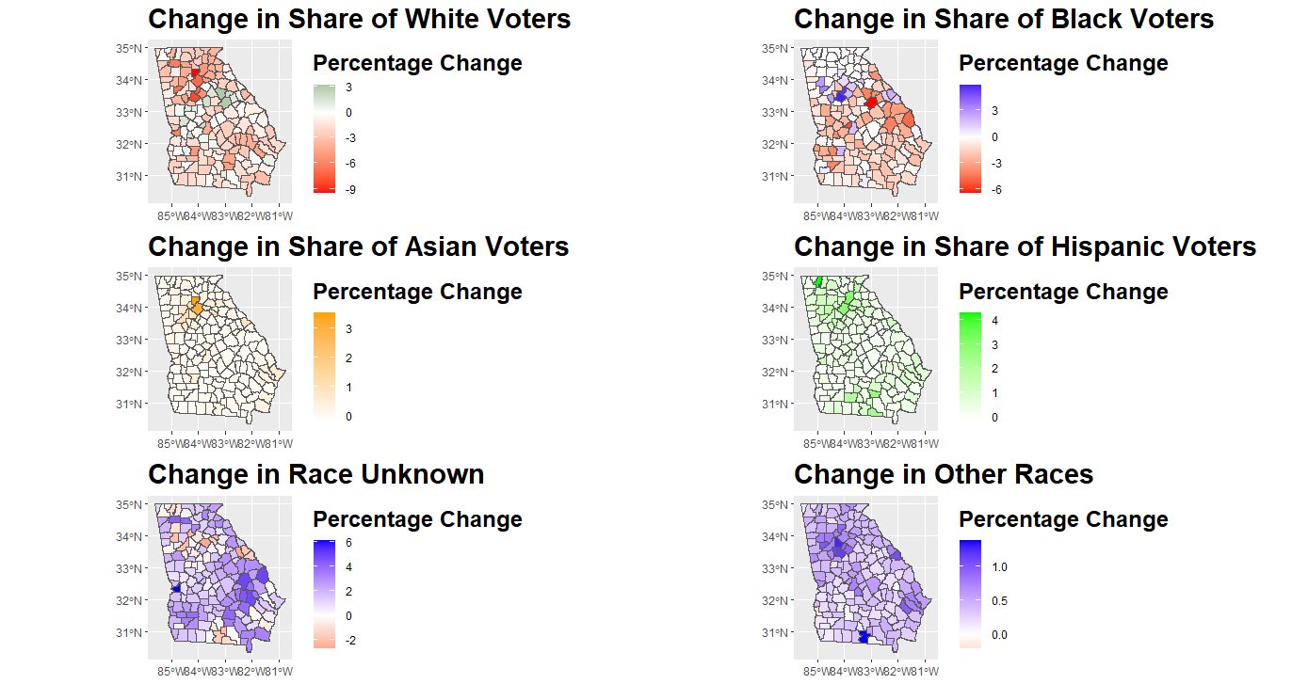
Racial Composition Change, 2016-2020
Notes:
Albert

Slide 13
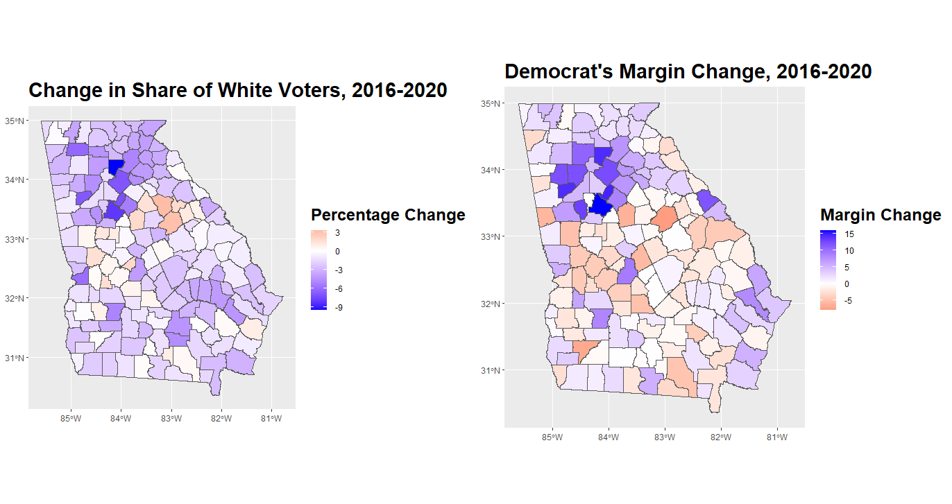
Decline in White Vote Correlates with Swing to Democrats
Notes:
Albert

Slide 14
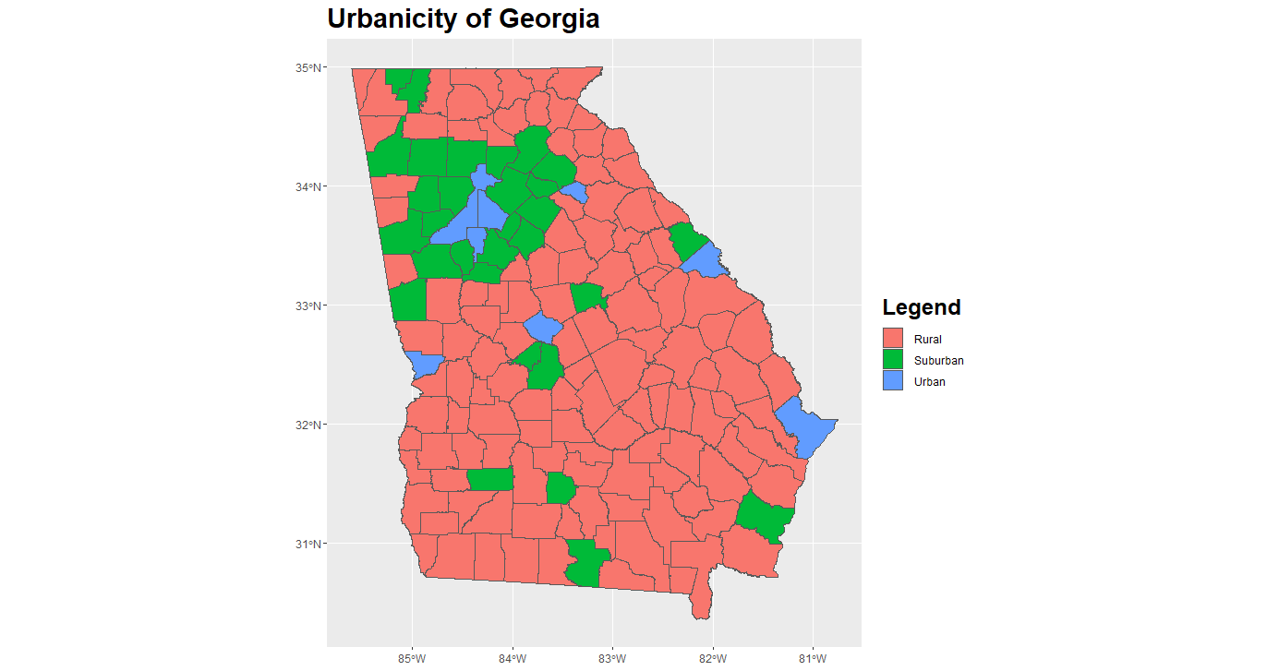
Major Cities:
Atlanta
Athens
Columbus
Macon
Augusta
Savannah
Notes:
Manthan

Slide 15
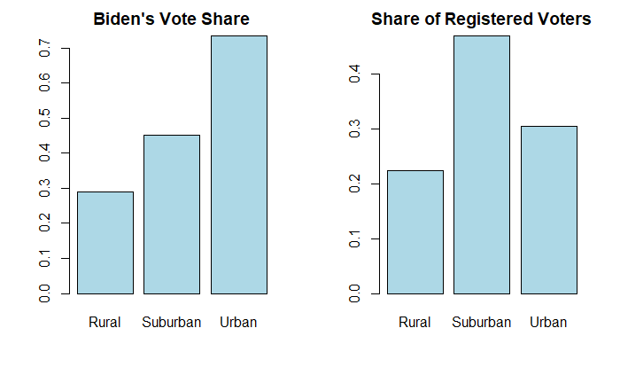
Vote Share Analysis: Urbanicity
Notes:
Manthan

Slide 16
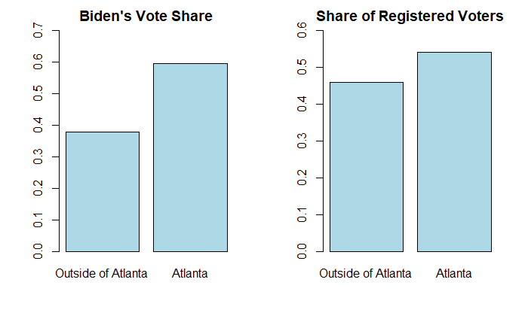
Vote Share Analysis: Atlanta Metro Counties
Notes:
Albert

Slide 17
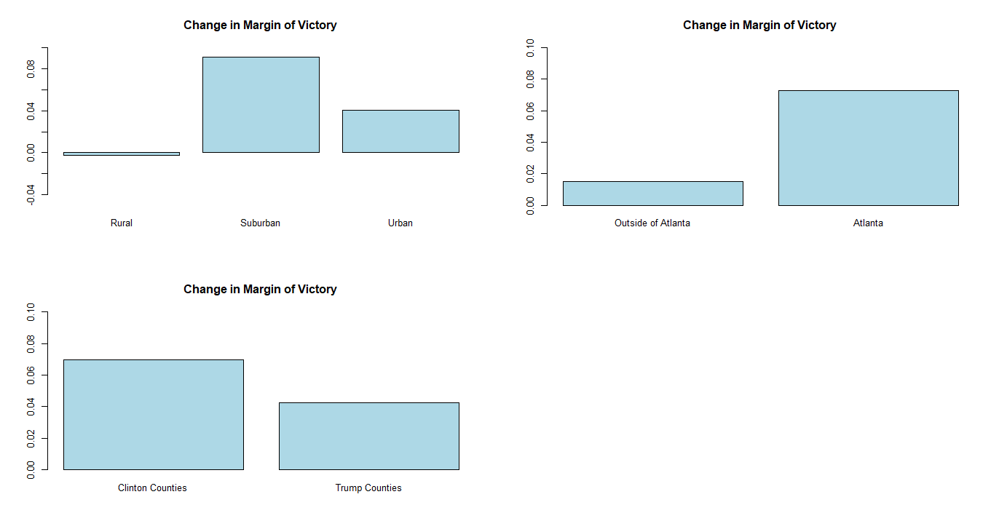
Where did the Democrats improve more?
Democrat’s improvement is concentrated around Atlanta and the suburbs.
Rural Counties are even more pro-Trump in 2020.
Notes:
Albert

Slide 18
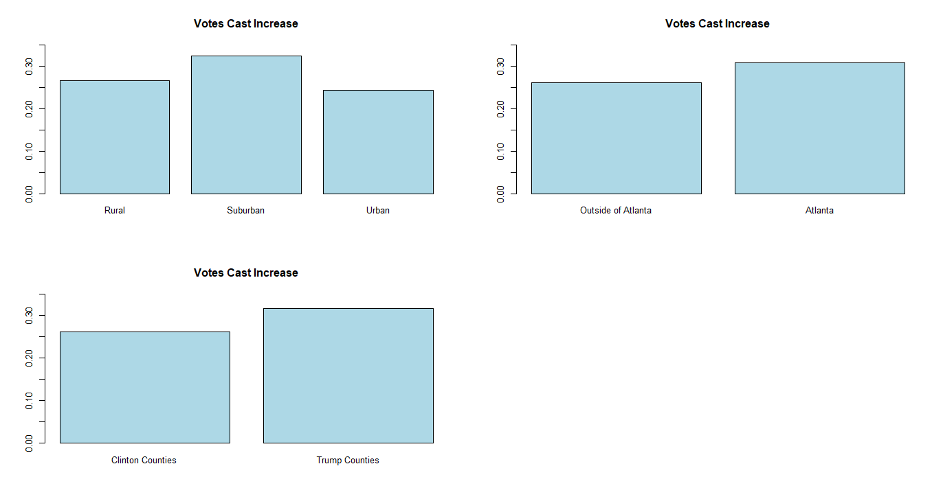
Increase in Votes Cast
Suburban areas see highest vote growth
Essentially a proxy for population growth
Notes:
Christina

Slide 19
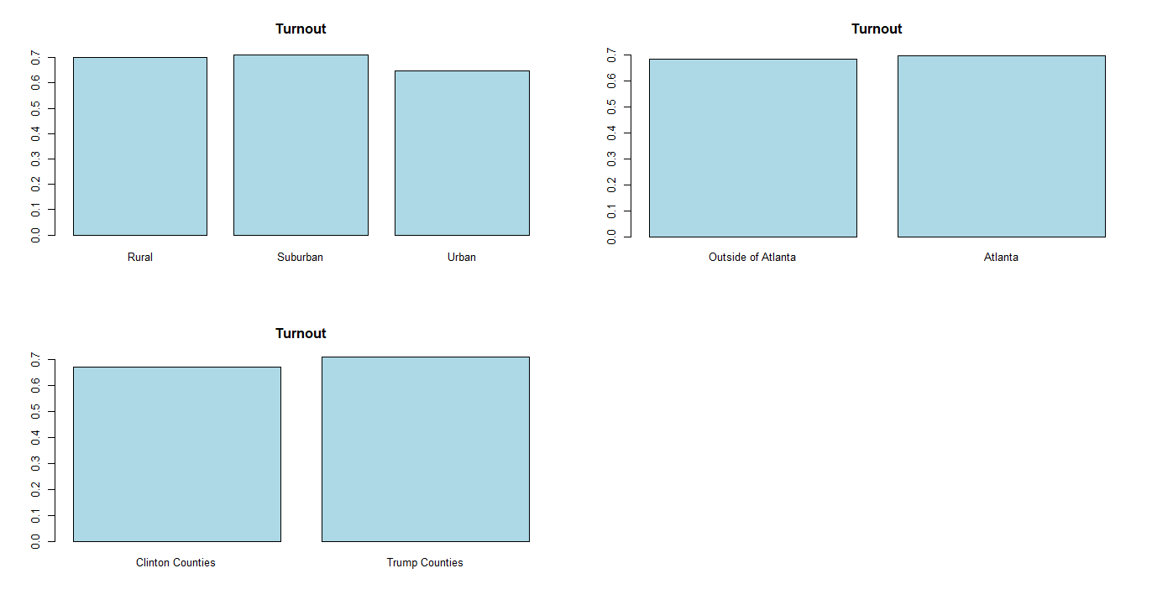
Where had higher voter turnout?
Turnout is noticeably lower in urban areas
Trump counties have higher turnout
Notes:
Christina

Slide 20
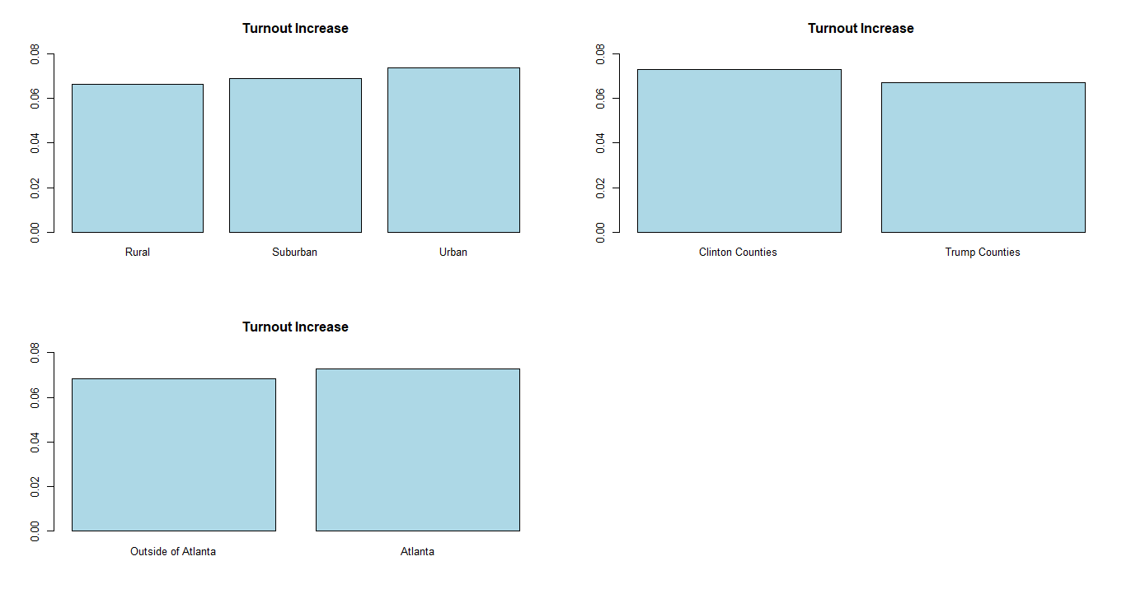
Turnout Increase from 2016
Turnout increase was higher in Democratic strongholds.
Notes:
Christina

Slide 21
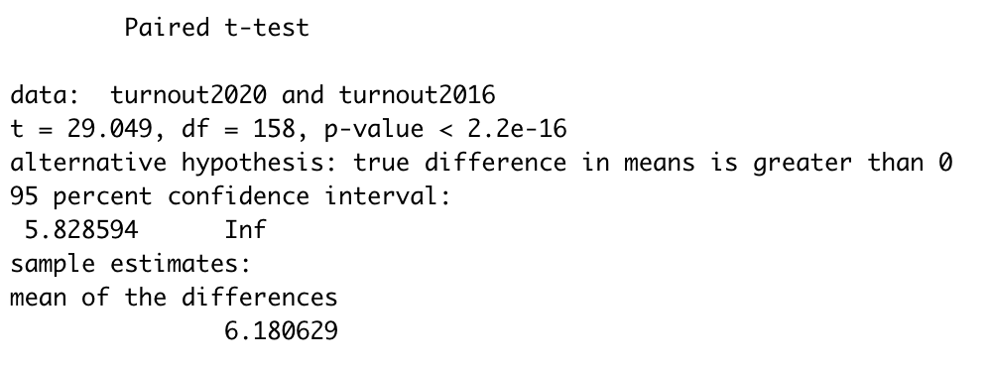
Hypothesis Test for Turnout
Test the hypothesis that the mean of Turnout (the total votes of the 2020 election) is greater than the mean of Turnout2016 (the total votes of the 2016 election) with a 5% significance level.
Conclusion: The p-value is 2.2e-16 which is less than our significance level 0.05, so we reject the null hypothesis. There is significant evidence that the mean of Turnout is greater than the mean of Turnout2016.
Notes:
Christina

Slide 22
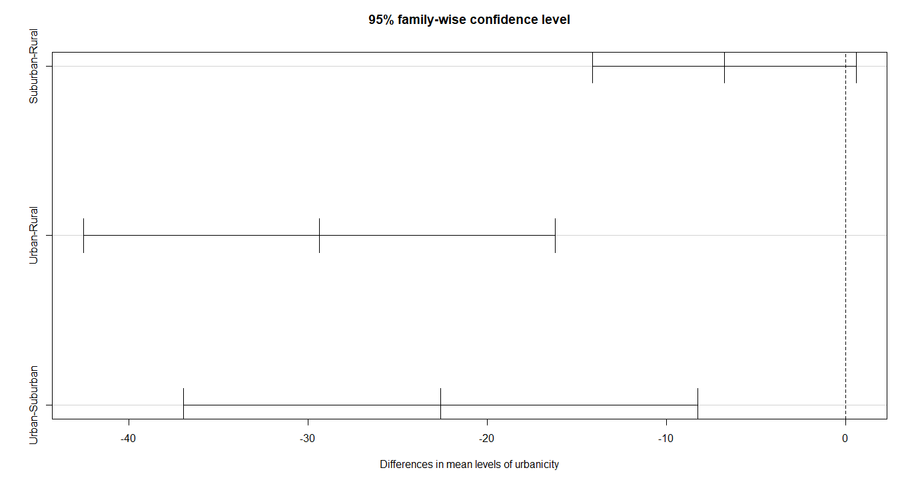
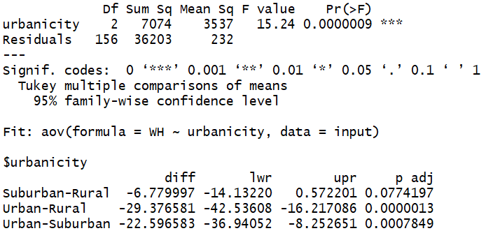
Mean Share of White Voters, Grouped by Urbanicity
Conclusion: Urban Counties are more racially diverse
Notes:
Joshua

Slide 23
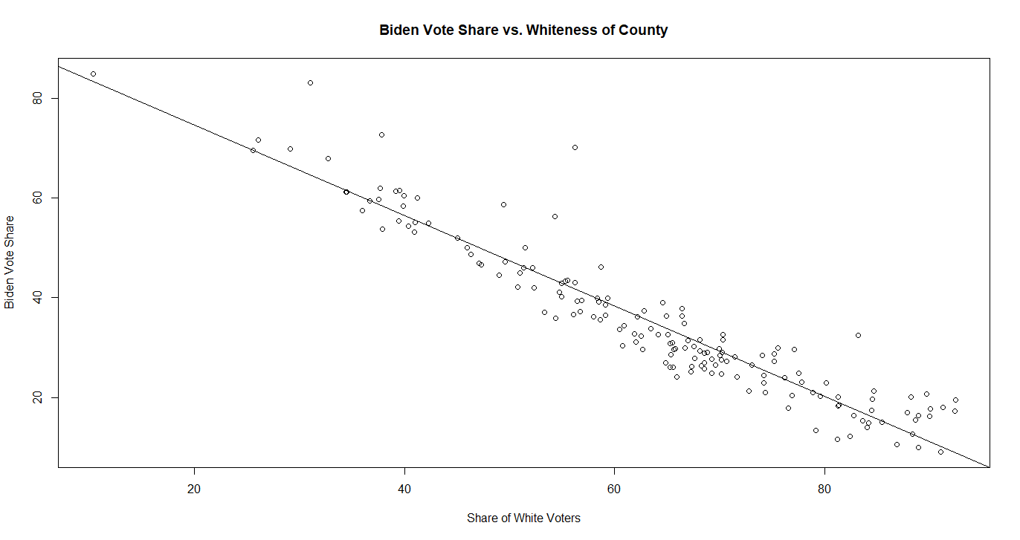
Best Predictor of Dem Vote: Whiteness (or lack thereof)
R² = 0.8951
y=92.84-0.9082x
Notes:
Albert

Slide 24
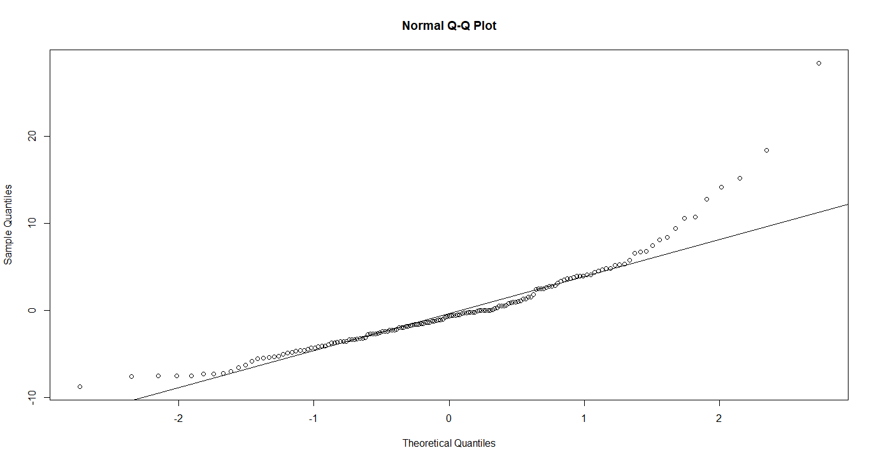
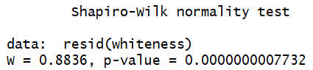
Residual Analysis
Confidence Interval | 2.5% | 97.5%
Intercept | 89.63 | 96.05
Whiteness | -0.957 | -0.859
Residuals are not normally distributed, but fit of data is very good in the middle portion.
Notes:
Albert

Slide 25
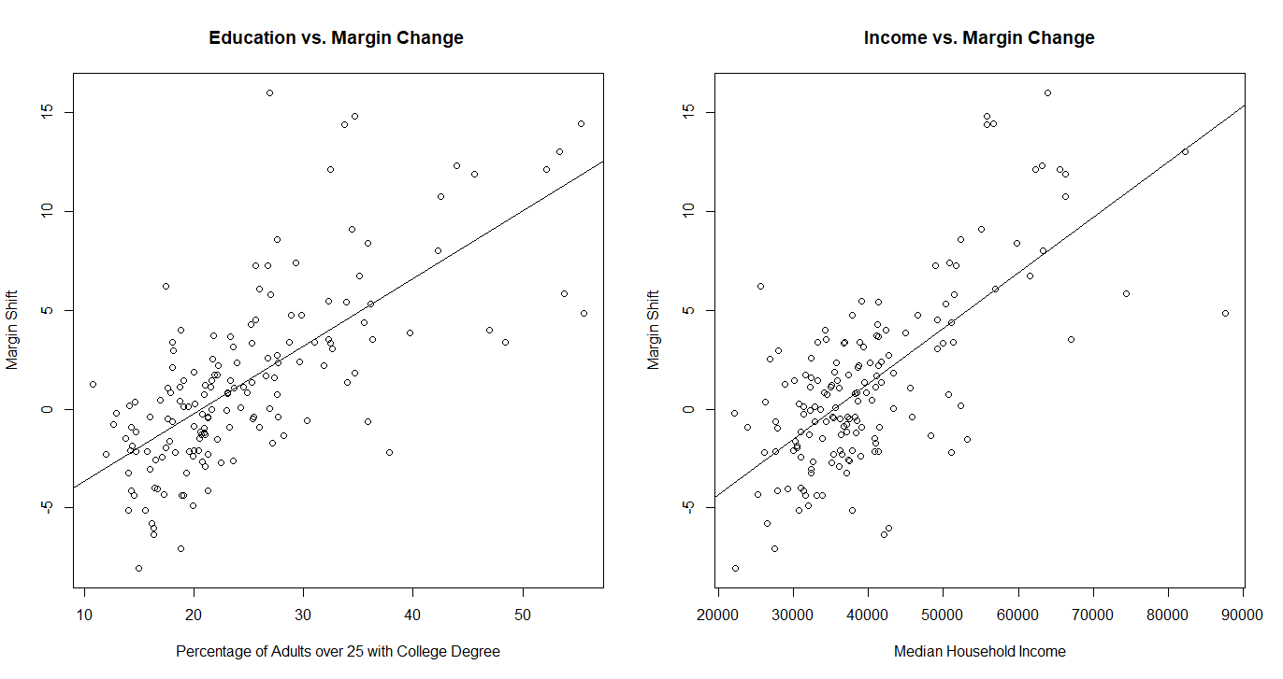
Education and Income fairly correlated to Dem Swing
R² = 0.48
R² = 0.49
y=0.3420x-7.0747
y=0.00028x-9.9839
Notes:
Albert

Slide 26
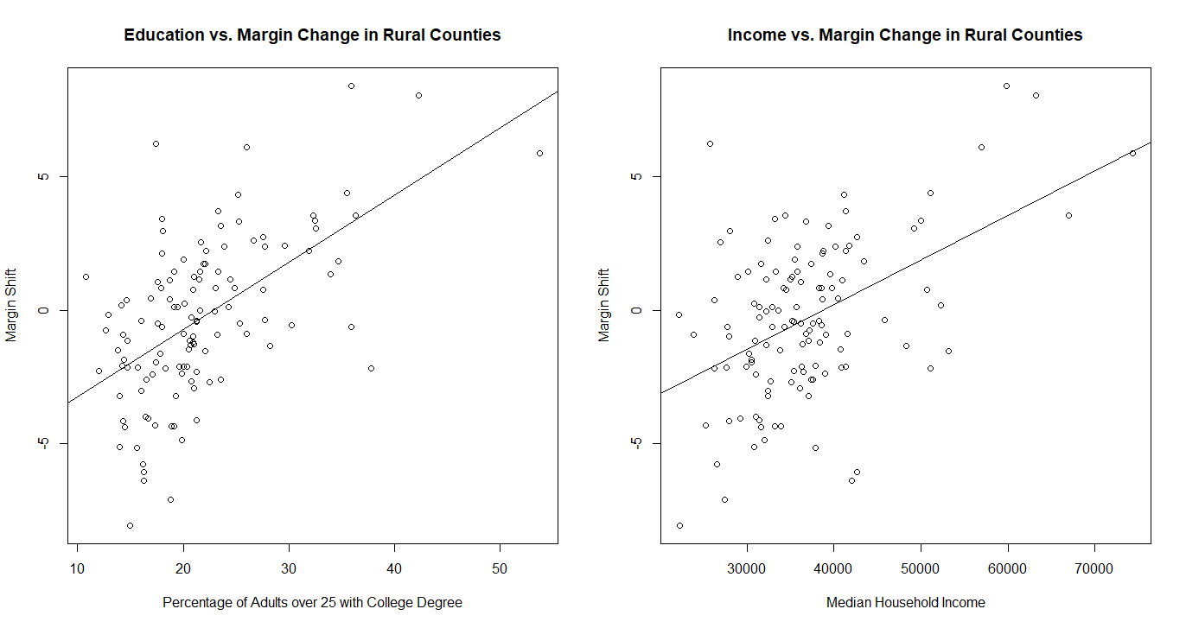
Closer Look at Income and Education vs. Shift to Dem
R² =0.3265
R² =0.2285
In the bivariate linear regression, the correlation with income is no longer significant (p=0.164)
Urbanicity is a confounding variable
y=0.2508x-5.7436
y=0.000166x-6.448
Notes:
Albert

Slide 27
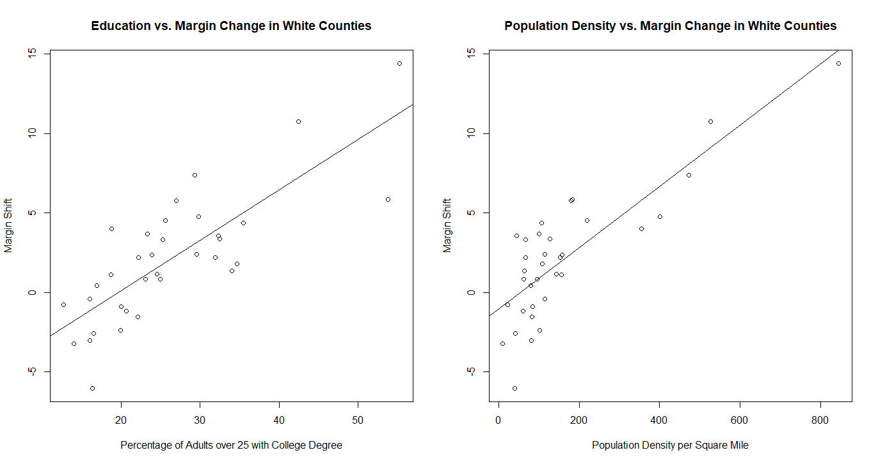
Focusing on Counties that are <10% Black: Better Fit
Population density becomes a more significant predictor than income
R² =0.6322
R² =0.6822
A model with these 2 variables have R²=0.81
y=0.3171x-6.2229
y=0.01924x-1.0176
Race is a confounding variable
Notes:
Albert

Slide 28
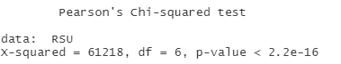
Vote Method Preference of Urban, Suburban, and Rural Voters
 | Rural | Suburban | Urban | Total
Election Day | 280,025 | 472,712 | 223,729 | 976,466
Mail | 223,986 | 654,004 | 438,789 | 1,316,788
Early Vote | 636,575 | 1,288,881 | 762,073 | 2,687,529
Provisional* | 790 | 4,137 | 6,228 | 11,155
Total | 1,141,376 | 2,419,734 | 1,430,828 | 4,991,938
Urban and Suburban voters are much more likely to vote by mail.
In-person early vote is the most popular method of voting
Rural voters are more likely to vote on election day than urban voters.
Provisional ballots are concentrated in urban counties.
*Nobody elects to vote by provisional ballot, but is tabulated separately so we give it its own category
Notes:
Joshua

Slide 29
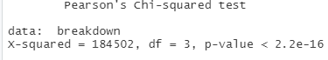
Vote Method Preference of Biden vs. Trump Voters
 | Biden | Trump | Total
Election Day | 367,336 | 588,500 | 955,836
Early Vote | 1,248,030 | 1,414,363 | 2,662,393
Mail | 849,597 | 451,135 | 1,300,732
Provisional* | 7039 | 3882 | 10,921
Total | 2,472,002 | 2,457,880 | 4,929,882
Most people voted early in person.
Biden supporters were much more likely to vote by mail.
More Trump supporters voted in person.
Provisional ballots went overwhelmingly for Biden.
*Nobody elects to vote by provisional ballot, but is tabulated separately so we give it its own category
Notes:
Joshua

Slide 30
Vote Method Breakdown of Biden and Trump Voters, by Urbanicity
Biden | Rural | Suburban | Urban | Total
Election Day | 0.172 | 0.451 | 0.378 | 0.149
Mail | 0.130 | 0.457 | 0.412 | 0.344
Early Vote | 0.126 | 0.428 | 0.447 | 0.505
Provisional | 0.039 | 0.294 | 0.667 | 0.003
Total | 0.134 | 0.441 | 0.425 | 1.000
Trump | Rural | Suburban | Urban | Total
Election Day | 0.361 | 0.503 | 0.136 | 0.239
Mail | 0.246 | 0.568 | 0.186 | 0.184
Early Vote | 0.336 | 0.525 | 0.140 | 0.575
Provisional | 0.129 | 0.513 | 0.358 | 0.002
Total | 0.325 | 0.527 | 0.147 | 1.000
Ratios listed represent the composition of each row
Urban voters are less likely to vote on election day, regardless of whom they support
Suburban voters are more likely to vote by mail, regardless of whom they support
Rural voters are more inclined to vote on election day, regardless of whom they support
Vote preferences of Biden and Trump voters are statistically different in every urbanicity setting.
Notes:
Albert

Slide 31
Conclusions
Democrat’s strength is in urban and suburban areas.
There is significant turnout increase in 2020 across the board compared with 2016.
Turnout increase is higher in Democratic areas in 2020, but Republican counties still have higher turnout
Biden was propelled to victory by racking up large margins around Atlanta, bur rural areas are even more Republican in 2020.
Whiteness and Democratic vote share have a strong negative correlation
Both party preference and urbanicity influence the method by which one votes
Notes:
Joshua (1)
Christina (2)
Albert (3, 4, 5, 6)

Slide 32
Issues
Finding data already in Excel or CSV files
Had to make some of our own spreadsheets of data
Impractical layouts on websites/ not copy-and-paste friendly
Census website could have been useful but was difficult to navigate
Data set is NOT a random sample of the population, and sample size relative to population size is extraordinarily large.
Downloaded excel not in readable form in R (preprocessing required)
Notes:
Christina (points 1,2,3)
Josh (4)
Albert (5,6)

Slide 33
Questions for Future Exploration: Precinct-Level Analysis
Where in Atlanta and the surrounding suburbs did the Democrats gain most ground?
Was income and a good predictor of Democratic swing?
To what extent did minority population increase in the suburbs contribute to the Democrat’s improved margins?
Who are the race “unknowns”? (even NYT may have gotten this wrong!)
Notes:
Albert

Slide 34
All our codes and data can be found in this GitHub repository
https://github.com/lsugyen/2020-Georgia-Election-Analysis/blob/master/README.md
Questions?
Notes:
Albert

